Slide 1
CA LAB 5

Slide 2
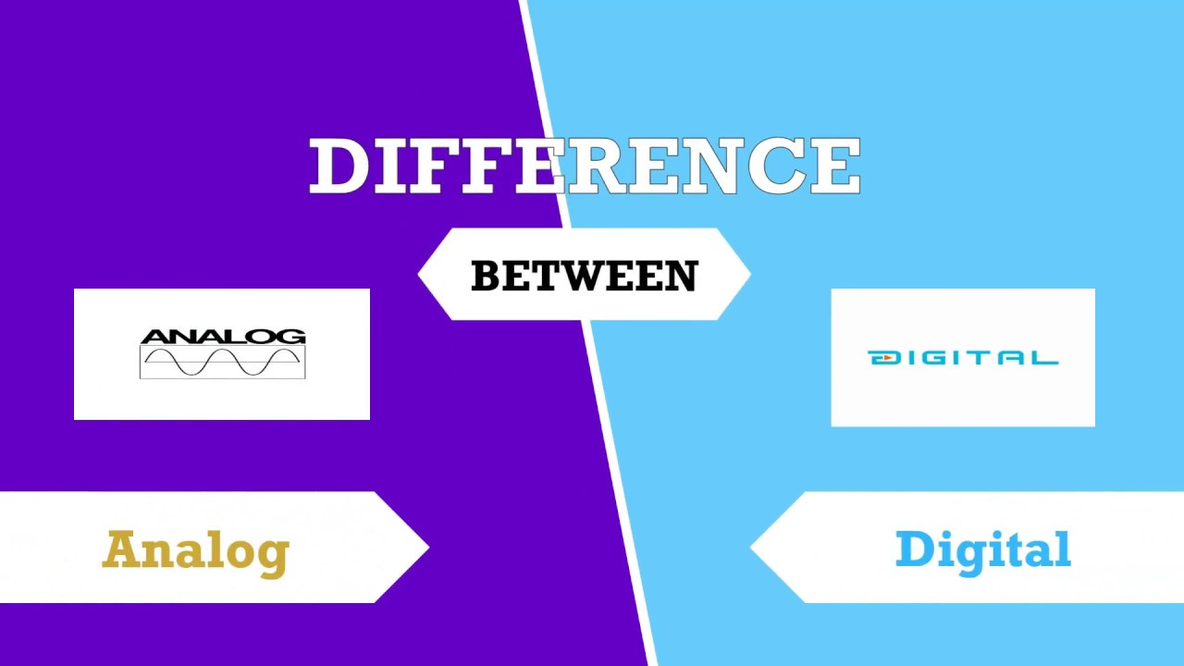

Slide 3
Analog
Digital
An analog signal signifies a continuous signal that keeps changes with a time period.
Analog signals are continuous sine waves
Analog signals describe the behavior of the wave with respect to amplitude, time period, & phase of the signal.
A digital signal signifies a discrete signal that carries binary data and has discrete values.
Digital signal is square waves.
Digital signals describe the behavior of the signal with respect to the rate of a bit as well as bit interval.

Slide 4
Analog
Digital
Analog signal range will not be set.
An analog signal broadcasts the information in the signal form.
The example of an analog signal is the human voice
Digital signal is limited as well as ranges from 0 to 1.
A digital signal broadcasts the information in the form of binary that is bits.
The example of a digital signal is the data transmission in a computer.

Slide 5
What Is I/O?
Let's start with the basics. I/O stands for "Input/Output." This means that we are talking about all the ways that our systems(Robotics, computer, IoT) can interact with the real world.
Input usually refers to sensors, e.g. switches, potentiometers, cameras, etc. Output usually refers to the motors of the robot's joints, but it can also mean warning lights, alarms, etc.

Slide 6
Analog vs Digital Sensors
Imagine that you want to detect whether a door is open or closed. You set up two different circuits, each with a different sensor:
An on/off switch placed on the door frame. This is a digital input. It will allow you to detect when the door is closed and when it is open, but will not detect anything between these states

Slide 7
Analog vs Digital Sensors
2) A potentiometer attached to the door hinge. This is an analog input. It will allow you to detect the amount that the door is open or closed. For example, you could use it to tell if the door was 50% open, 12.3376…% open, or any other amount between completely closed (0% open) and completely open (100% open).

Slide 8
Analog vs Digital Sensors
Let's imagine that you attach a light bulb as an output to both circuits. This is an analog output. This is what will happen to the light bulb using both sensors:
On/off switch. When the door closes, the light bulb will turn off. When it opens, the light bulb will turn on.
Potentiometer. The light bulb will dim depending on the amount that the door is open. When the door is 25% open, for example, the light bulb will be at a quarter of its full brightness.

Slide 9
Analog vs Digital Processing
Analog and digital processing differ in two fundamental ways:
How they handle time:
Analog processing is continuous. As soon as an input changes, the output also changes. The only delay is the time it takes for processing

Slide 10
Analog vs Digital Processing
Digital processing is discrete. When an input changes, there is a delay until the system registers the change. The length of this delay is determined by the "sampling frequency" and is controlled by a clock.

Slide 11
Analog vs Digital Processing
2) How they affect resolution:
Analog processing has a theoretically infinite resolution as the signal is not rounded. Like any infinite number, this infinite resolution is never achievable in practice.
Digital processing can only handle signals which are represented as 0 or 1 (on/off). All signals must be reduced to a binary number, which involves rounding the value.

Slide 12
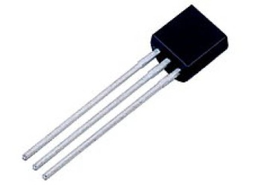
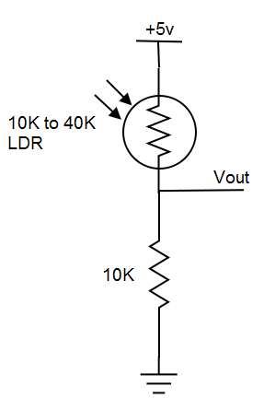
Analog sensors
LM35: Digital Thermometer
Output Type: Analog
Output Scale: 10mV / °C
Light Dependent Resistor (LDR)
Voltage divider (half-bridge) circuit is used to detect the change in light intensity.
Vout changes as the resistance of LDR changes

Slide 13
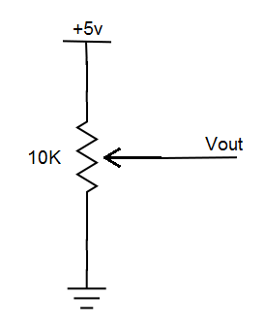
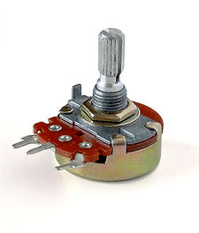
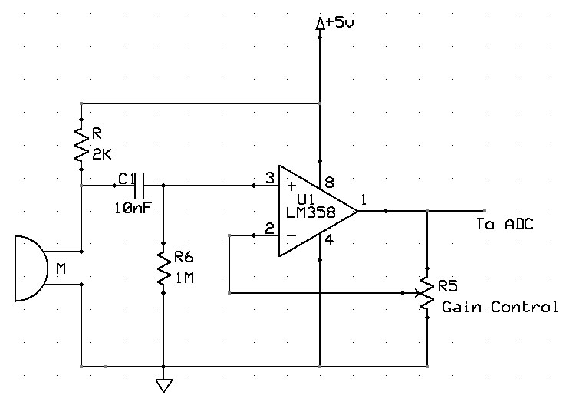
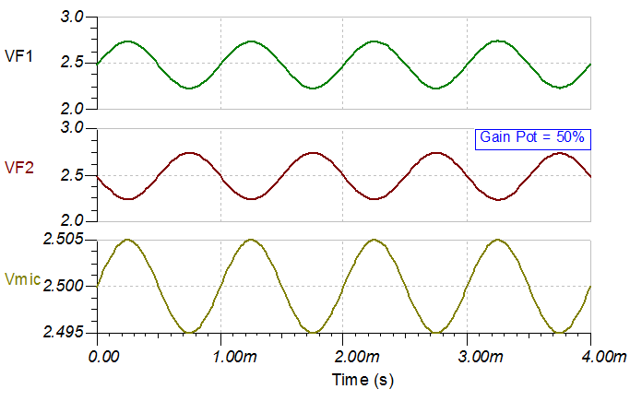
Analog sensors
Potentiometer (Absolute Encoder)
Microphone with Pre-amplifier

Slide 14
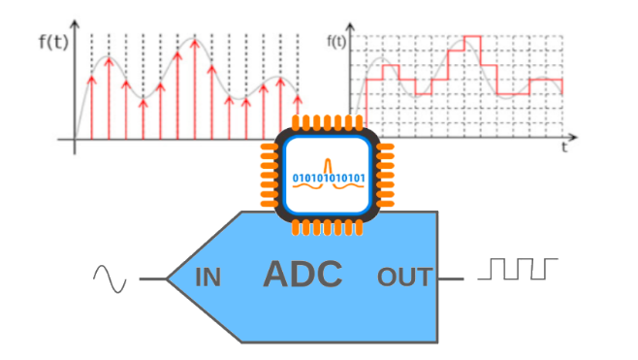

Slide 15
What is the ADC?
ADC is a system which converts analog signal into a digital signal.
An Analog to Digital Converter (ADC) is a very useful feature that converts an analog voltage on a pin to a digital number. By converting from the analog world to the digital world, we can begin to use electronics to interface to the analog world around us.

Slide 16
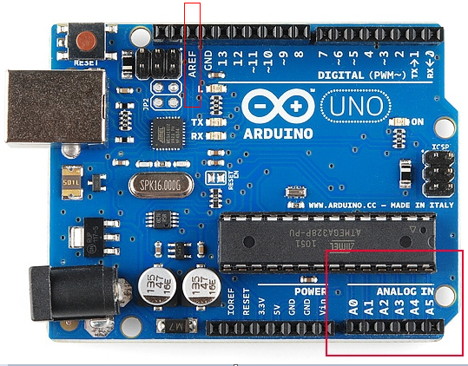

Slide 17
Analog Pins
Not every pin on a microcontroller has the ability to do analog to digital conversions.
In Arduino Uno there are 6 analog pins from (A0 to A5).
These pins can read and write analog values.
These analog pin can also be used as digital pins but digital pins can’t be used as analog pins.

Slide 18
ADC
ADCs can vary greatly between microcontroller.
The ADC on the Arduino is a 10-bit ADC meaning it has the ability to detect 1,024 (2^10) discrete analog levels.
The resolution of ADC depend upon the bits.
It takes about 100 microseconds (0.0001 s) to read an analog input.

Slide 19
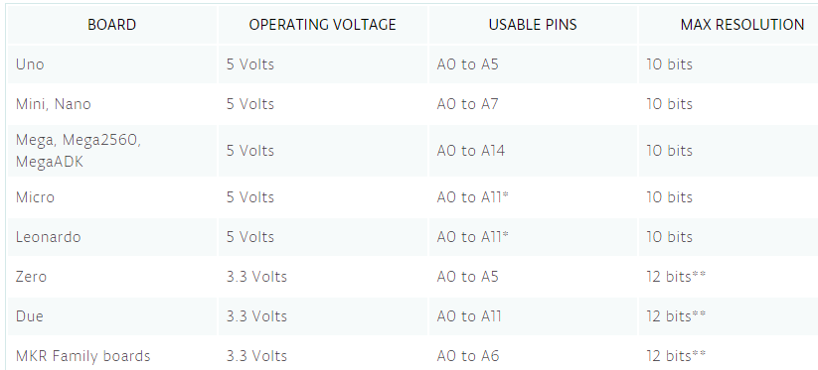

Slide 20
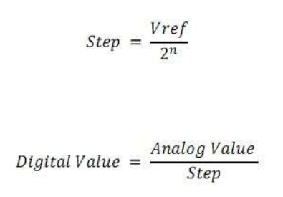
ADC Formula & Calculation

Slide 21
ADC Formula & Calculation
Take n=10, vref= 5V and calculate the steps.
Then take the analog value 2.4 and calculate it’s digital value.

Slide 22

Relating ADC Value to Voltage

Slide 23
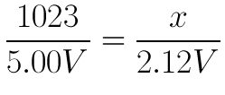
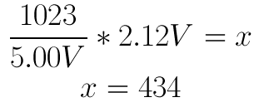
Relating ADC Value to Voltage

Slide 24
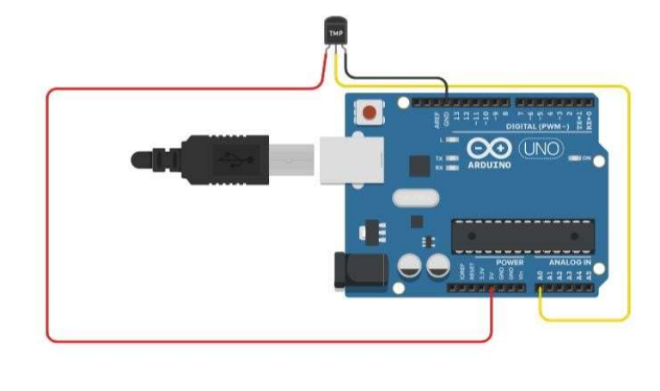
Measuring Temperature

Slide 25
Code
void setup()
{
pinMode(A0, INPUT);
analogReference(INTERNAL);
Serial.begin(9600);
}
void loop()
{
int reading=analogRead(A0);
float tempC= reading / 9.31;
Serial.println(tempC);
delay(1000);
}

Slide 26
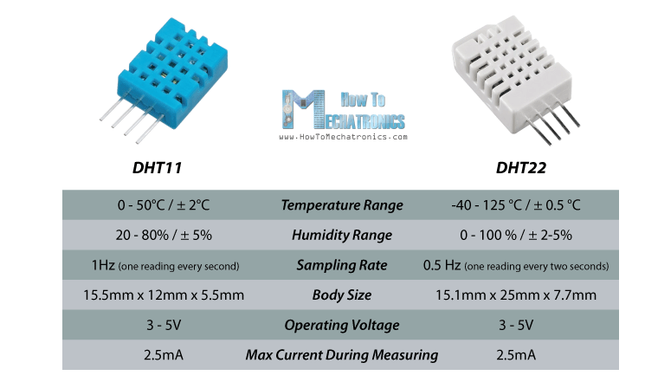
DHT 11 & 22

Slide 27
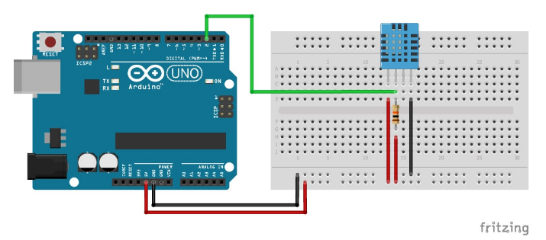

Slide 28
Code
#include <dht.h>
dht DHT;
#define DHT11_PIN 2
void setup(){
Serial.begin(9600);
}
void loop()
{
int chk = DHT.read11(DHT11_PIN);
Serial.print("Temperature = ");
Serial.println(DHT.temperature);
Serial.print("Humidity = ");
Serial.println(DHT.humidity);
delay(1000);
}

